Slide 1
Secure Software Software Engineering & Security

Slide 2
Elevation of Privilege and Control-Alt-Hack - Discussion
Are these games? Serious games?
What are the learning objectives?
What are the mechanics?
How do the mechanics facilitate the learning objectives?
Methodology? Did testing show they accomplished what they wanted to?
Was there anything you found particularly interesting? Or helpful?
*
How long did you spend reading and assessing these articles?

Slide 3
Software is Eating the World - Discussion
Overview – what’s the paper about?
Is software development continuing to surge?
What are some of the industries being transformed by software?
What’s next?
Software versus Service
*
How long did you spend reading this article?

Slide 4
Software Engineering Review
What is software engineering [or CSCE 593 in ~10 slides]?
The 4-P’s of software engineering
What process should we use?
*

Slide 5
Software Engineering Review
What is software engineering [or CSCE 593 in ~10 slides]?
Software engineering is the application of a systematic, disciplined, quantifiable approach to the development, operation, and maintenance of software. (IEEE)
Systematic – there is a method or plan
Disciplined – rigorous, behavior in accord with rules (a branch of learning or instruction)
Quantifiable – measurable (in terms of time, money, people, LOCs, etc.)
*

Slide 6
Software Engineering Review
What is software engineering [or CSCE 593 in ~10 slides]?
The 4-P’s of software engineering (Pressman, 2001)
Focus on the 4-P’s during project management
Project (the task at hand)
People (by whom it is done)
Process (the manner it is done)
Product (the artifacts produced)
*

Slide 7
Software Engineering Review
What is software engineering [or CSCE 593 in ~10 slides]?
The 4-P’s of software engineering
What process should we use?
Process:
requirements analysis/definition
system design
implementation (coding)
testing (unit, integration, system)
delivery
maintenance
*

Slide 8
Steps to be performed - Project Planning
Project Planning
Requirements Analysis
System Design
Implementation
Testing
Delivery
Maintenance
*

Slide 9
Steps to be performed – Requirements
Project Planning
Requirements Analysis
System Design
Implementation
Testing
Delivery
Maintenance
*

Slide 10
Steps to be performed – System Design
Project Planning
Requirements Analysis
System Design
Implementation
Testing
Delivery
Maintenance
*

Slide 11
Steps to be performed - Implementation
Project Planning
Requirements Analysis
System Design
Implementation
Testing
Delivery
Maintenance
*

Slide 12
Steps to be performed - Testing
Project Planning
Requirements Analysis
System Design
Implementation
Testing
Delivery
Maintenance
*

Slide 13
Steps to be performed - Delivery
Project Planning
Requirements Analysis
System Design
Implementation
Testing
Delivery
Maintenance
*

Slide 14
Steps to be performed - Maintenance
Project Planning
Requirements Analysis
System Design
Implementation
Testing
Delivery
Maintenance
*

Slide 15
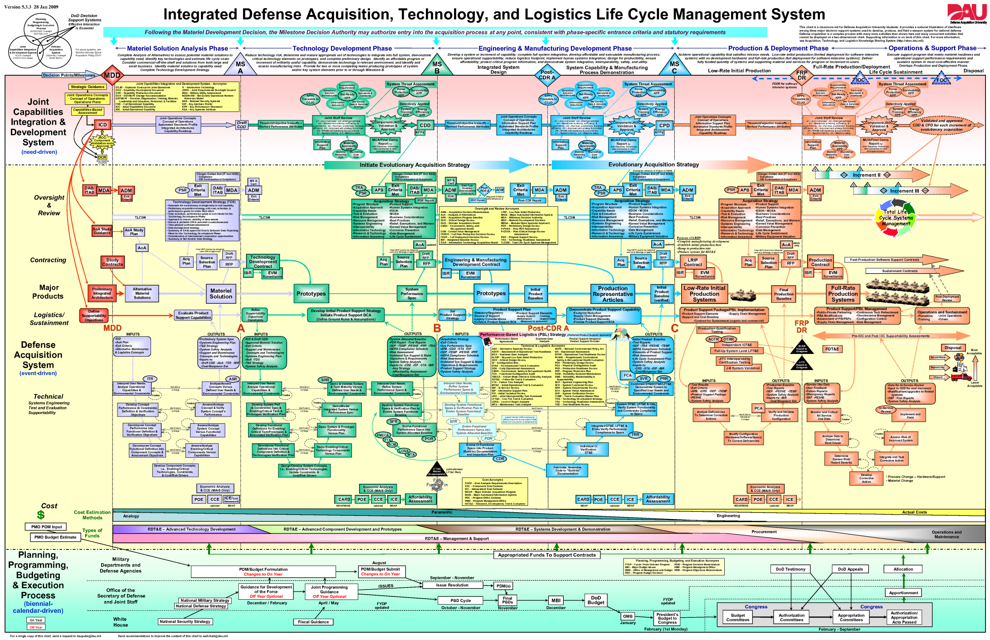

Slide 16
Software Engineering
Where does security fit in all of this??!!

Slide 17
Designing Secure Software
“Software is the common Achilles’ heel…”
Essential, powerful, and ubiquitous: a recipe for disaster
Software fails and breaks
Weaknesses in software become exploits of an adversary
What’s the difference between software safety and software security?
Hoglund, G. and McGraw, G., Exploiting Software, Pearson Education, 2004

Slide 18
Designing Secure Software
“More lines = more bugs”
Systems such as these tend to have 5-50 bugs per KLOC!
“Success is foreseeing failure” -Henry Petroski
Mistakes are inevitable, but controllable
System | Lines of Code
Linux Kernel 2.2.0 | 1.5 million
F-22 | 1.7 million
Boeing 777 | 7 million
F-35 | 8 million
Netscape | 17 million
Windows XP | 40 million
Hoglund, G. and McGraw, G., Exploiting Software, Pearson Education, 2004

Slide 19
Software Security - Discussion
Overview – what’s the paper about?
Software security versus application security
Operators versus builders
Security is an emergent property of a software system – thoughts?
Was there anything in particular you found interesting? Useful?
*
How long did you spend reading this article?

Slide 20
Designing Secure Software
Security Features != Secure Software
In many cases, security failures are not related to security features at all
Defective non-security features go wrong with much greater frequency
Baking-in Security versus Sprinkling Security Features on top
Designing with security in mind
Adding on security features at the end
Chess, B. and West J., Secure Programming w/ Static Analysis,Pearson Education, 2007
*

Slide 21
Designing Secure Software
“Reliable software does what it is supposed to do; secure software does what it is supposed to do and nothing more”
Ivan Arce, CTO of Core Security Technologies
What do you test?
Chess, B. and West J., Secure Programming w/ Static Analysis,Pearson Education, 2007

Slide 22
Software’s Invisible Users - Discussion
Overview – what’s the paper about?
How do these invisible users impact testing?
Are these users involved in all software?
Was there anything in particular you found interesting? Useful?
*
How long did you spend reading this article?

Slide 23
What do we mean by secure?
CIA² model
Confidentiality
Integrity
Availability
Authentication
(Non Repudiation)
*

Slide 24
Designing Secure Software
What is defensive driving?
What is defensive programming?
Can defensive programming guarantee secure software?
Chess, B. and West J., Secure Programming w/ Static Analysis,Pearson Education, 2007
*

Slide 25
24 Deadly Sins of Software Security
“95% of software bugs are caused by the same set of programming flaws”
Buffer Overruns
Format String Problems
Integer Overflows
Poor Usability
Not Updating Easily
Failing to Handle Errors Correctly
Catching Exceptions
Code with too much Privilege
SQL Injection
Command Injection
Information Leakage
Failing to Store and Protect Data Securely
Use of Weak Password-Based Systems
Weak Random Numbers
Using Cryptography Incorrectly
Race Conditions
Web Server--Related Vulnerabilities
Web Client-Related Vulnerabilities
Use of Magic URLs and Hidden Form Fields
The Sins of Mobile Code
Failing to Protect Network Traffic
Improper Use of PKI
Trusting Network Name Resolution
*Not just C programming language, but we’ll primarily use C for the labs

Slide 27
C Arcade and OnlineGDB

Slide 29
Famous Failures
Denver Airport Baggage Handling System (1995)
NASA Mars Polar Lander (2000)
Therac25 (1980s)
Mars Climate Orbiter (1999)
USS Vincennes (1988)
USS Yorktown (1997)
Pentium Chip (1994)
Northeast Blackout (2003)
Federal Student Loan Software Upgrade (2006)
Ariane 5 Failure (1996)
PCA Pumps (1988-2000)
Tennessee Lottery (2007)
*

